Slide 1
Physics Signal
Classification
Separating Gamma Rays from Hadronic Backgrounds
in Telescope Data
Shahab Zaman
MSc Data Science | University of Hertfordshire | January 2025

Slide 2
Introduction
Research Context
Objectives
Ground-based Imaging Atmospheric Cherenkov Telescopes (IACTs) detect high-energy gamma rays by capturing the faint flashes of Cherenkov light produced when these rays interact with Earth's atmosphere.
The central challenge is distinguishing genuine gamma-ray signals from the far more abundant hadronic cosmic-ray background, which produces visually similar shower images.
The MAGIC telescope system, located in the Canary Islands, is one of the world's leading instruments for this kind of very-high-energy astrophysics research.
This project applies machine learning to automate the classification task, potentially improving detection sensitivity beyond traditional hand-crafted parameter cuts.
Classify telescope events as gamma-ray signals or hadronic background using supervised ML models.
Compare distance-based (KNN), boundary-based (SVM, Logistic Regression) classification approaches.
Employ Bayesian optimisation (BayesSearchCV) to systematically tune hyperparameters and improve F1-score.
Evaluate model robustness through 5-fold cross-validation within the tuning framework.
Identify the best-performing model for deployment in real-time telescope data pipelines.
Shahab Zaman | MSc Data Science | University of Hertfordshire
2 / 14

Slide 3
Previous Work
Traditional Approaches
Machine Learning in Astrophysics
Bayesian Optimisation
Early gamma/hadron separation relied on simple parameter cuts — selecting events based on image width, length, and alpha angle. Hillas (1985) introduced these parametric descriptors, which remained standard for two decades. While interpretable, such cuts struggle with overlapping feature distributions between signal and background.
Random Forests were first applied to MAGIC data by Albert et al. (2008), showing significant improvement over parametric methods. Bock et al. (2004) demonstrated that neural networks could enhance sensitivity by 20-40%. More recently, ensemble methods and gradient boosting have become popular in the high-energy physics community for particle classification tasks.
Traditional grid search scales poorly with dimensionality. Bayesian optimisation with Gaussian processes provides a principled, sample-efficient approach to hyperparameter tuning (Snoek et al., 2012). BayesSearchCV from scikit-optimize combines this with cross-validation, making it well-suited for computationally expensive models like SVM on medium-sized datasets.
Shahab Zaman | MSc Data Science | University of Hertfordshire
3 / 14

Slide 4
Approach & Novelty
01
Data Loading
02
Exploration
03
Preprocessing
Import the MAGIC Gamma Telescope dataset containing 19,020 Cherenkov image parameter records with 10 continuous features.
Examine class imbalance (65% gamma vs 35% hadron), feature distributions, KDE separation plots, and correlation structure.
Encode class labels, apply StandardScaler normalisation, and split data 80/20 for training and testing.
04
Baseline Models
05
Bayesian Tuning
06
Evaluation
Train KNN, Logistic Regression, and SVM with default parameters to establish performance benchmarks.
Use BayesSearchCV with 25 iterations and 5-fold CV to optimise each model's hyperparameters on F1-score.
Compare optimised models on accuracy, precision, recall, and F1. Identify SVM as the best classifier.
Shahab Zaman | MSc Data Science | University of Hertfordshire
4 / 14

Slide 5
Dataset Overview
19,020
10
2
0%
Total Records
Input Features
Classes
Missing Values
Feature | Type | Description
fLength | Float | Major axis of the ellipse (mm)
fWidth | Float | Minor axis of the ellipse (mm)
fSize | Float | Logarithm of the sum of content of all pixels
fConc / fConc1 | Float | Ratio of highest 2 / 1 pixel(s) to fSize
fAsym | Float | Distance from highest pixel to centre
fM3Long / fM3Trans | Float | 3rd-root of 3rd moment along major / minor axis
fAlpha | Float | Angle of major axis with vector to centre (deg)
fDist | Float | Distance from image centre to origin (mm)
class | Categorical | g = gamma (signal), h = hadron (background)
Source: UCI Machine Learning Repository — MAGIC Gamma Telescope Dataset
Shahab Zaman | MSc Data Science | University of Hertfordshire
5 / 14

Slide 6
Ethical Implications
No Personal Data
Reproducibility & Transparency
The dataset consists entirely of physical measurements from a telescope — photon shower parameters recorded by sensors. There is no personally identifiable information, eliminating privacy and consent concerns entirely.
All preprocessing steps, model configurations, and hyperparameter search spaces are fully documented. The dataset is publicly available from the UCI repository, enabling independent verification and reproducibility of all reported results.
Bias Considerations
Responsible Deployment
Class imbalance (65% gamma vs 35% hadron) could bias models toward the majority class. We address this by optimising on F1-score rather than accuracy, ensuring balanced precision-recall trade-offs for both signal and background events.
Misclassification in this domain affects telescope observation time, not human welfare. However, false positives waste limited observation resources while false negatives miss genuine astrophysical sources, making precision-recall balance operationally important.
Shahab Zaman | MSc Data Science | University of Hertfordshire
6 / 14

Slide 7
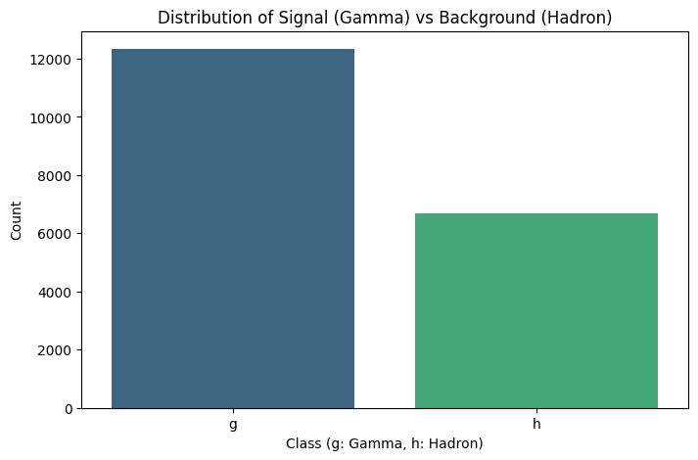
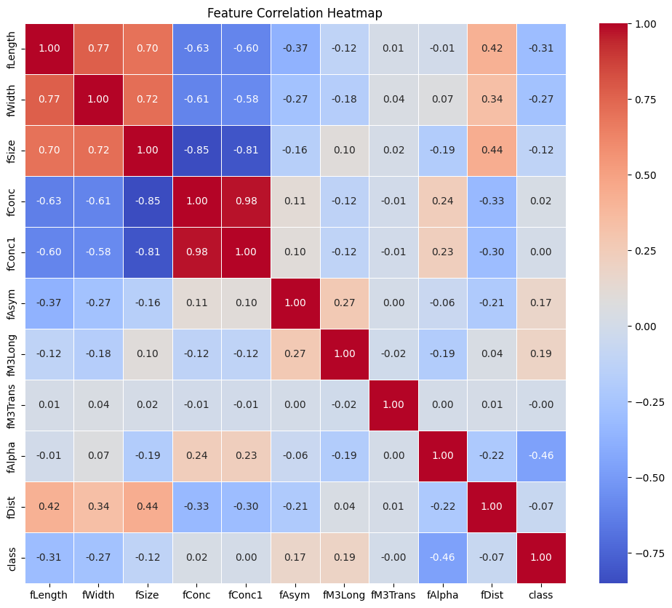
Exploratory Data Analysis
Key Findings
Class Imbalance: Gamma rays constitute 64.8% of events versus 35.2% for hadrons, creating a moderate imbalance that favours the majority class if accuracy alone is used.
Feature Separation: KDE plots reveal that fAlpha and fLength provide the strongest class separation, while fAsym and fM3Trans show substantial overlap.
Correlation Structure: fConc and fConc1 are highly correlated (r ≈ 0.90). fLength–fWidth correlation is moderate. No severe multicollinearity issues requiring feature removal.
Shahab Zaman | MSc Data Science | University of Hertfordshire
7 / 14

Slide 8
Data Preprocessing
1
Label Encoding
2
Feature Standardisation
The categorical target variable was encoded numerically using scikit-learn's LabelEncoder, mapping gamma rays ('g') to 1 and hadrons ('h') to 0. This binary encoding enables the use of standard classification algorithms and metric computation.
All 10 continuous features were standardised using StandardScaler (zero mean, unit variance). This is essential for distance-based models like KNN and SVM, where feature magnitude directly affects the distance computation and decision boundaries.
3
Train/Test Split
4
No Missing Data
The dataset was partitioned into 80% training (15,216 samples) and 20% testing (3,804 samples) using stratified random sampling to maintain the original class proportions in both subsets.
The dataset contains zero missing values across all 11 columns, confirmed by both numerical summary and visual heatmap inspection. No imputation or data cleaning was required, allowing direct model training on the full feature set.
Shahab Zaman | MSc Data Science | University of Hertfordshire
8 / 14

Slide 9
Models Used
Distance-Based
Boundary-Based
Boundary-Based
K-Nearest Neighbours (KNN)
Logistic Regression
Support Vector Machine (SVM)
Classifies each test event by a majority vote among its k nearest training neighbours in the standardised feature space. KNN is non-parametric, making no assumptions about the underlying data distribution. The 'distance' weighting scheme gives closer neighbours proportionally more influence, improving accuracy when class boundaries are irregular.
Fits a linear decision boundary by modelling the log-odds of the gamma class as a linear combination of all 10 features. Despite its simplicity, logistic regression provides well-calibrated probability estimates and serves as a strong interpretable baseline against which more complex models are compared.
Finds the maximum-margin hyperplane separating gamma and hadron events. With the RBF kernel, SVM can capture complex non-linear decision boundaries by mapping features into a high-dimensional space. Training is computationally intensive (O(n²) to O(n³)), but often yields superior accuracy on medium-sized datasets.
Default: k=5, weights=uniform, p=2 (Euclidean)
Default: solver=lbfgs, penalty=L2, max_iter=100
Default: kernel=rbf, C=1.0, gamma=scale, probability=True
Shahab Zaman | MSc Data Science | University of Hertfordshire
9 / 14

Slide 10
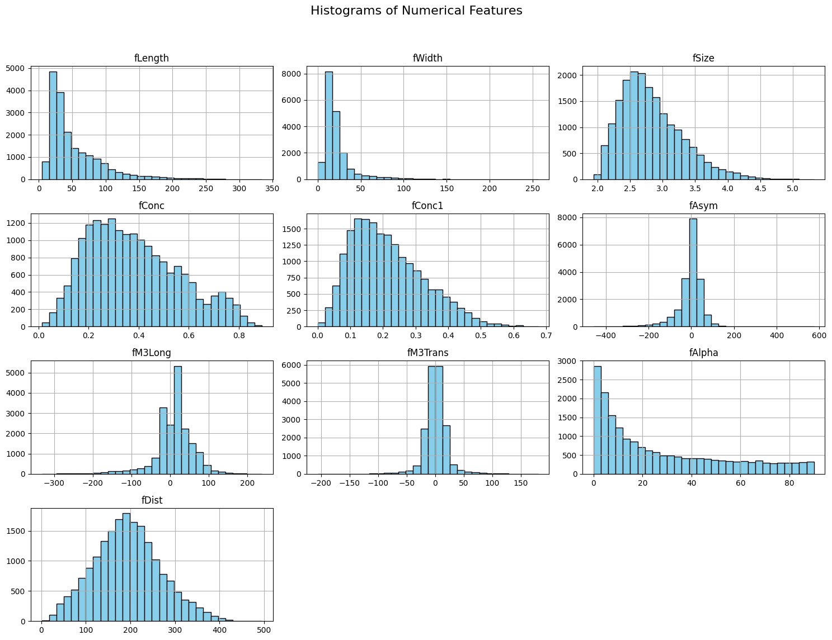
Baseline Model Results
Model | Accuracy | Precision | Recall | F1-Score
KNN (Distance-Based) | 0.8346 | 0.8415 | 0.6555 | 0.7369
Logistic Regression | 0.7931 | 0.7610 | 0.6042 | 0.6736
SVM (Boundary-Based) | 0.7936 | 0.7567 | 0.6131 | 0.6774
Interpretation
KNN leads on all metrics with default parameters — its non-parametric nature captures the non-linear class boundary well in standardised feature space.
SVM and Logistic Regression perform nearly identically at baseline. The default SVM (C=1.0, gamma=scale) has not been given enough regularisation freedom to separate the overlapping classes.
All models show notably lower recall than precision, indicating a tendency to miss gamma signals — a common pattern with the class imbalance present in this dataset.
F1-score is our primary evaluation metric since it balances precision and recall, both crucial in telescope signal classification.
Shahab Zaman | MSc Data Science | University of Hertfordshire
10 / 14

Slide 11
Hyperparameter Tuning
Bayesian Optimisation with BayesSearchCV | 25 iterations | 5-fold Cross-Validation | F1-Score Objective
KNN
SVM
Logistic Regression
Search Space
Search Space
Search Space
n_neighbors: [1, 30]
weights: uniform, distance
p: 1 (Manhattan), 2 (Euclidean)
C: [0.01, 100] log-uniform
gamma: [0.001, 0.1] log-uniform
kernel: rbf
C: [0.0001, 100] log-uniform
penalty: L2
solver: lbfgs, liblinear
Best Parameters
Best Parameters
Best Parameters
n_neighbors = 6
weights = distance
p = 2 (Euclidean)
C = 59.18
gamma = 0.0672
kernel = rbf
C = 0.7132
penalty = L2
solver = liblinear
CV F1: 0.7463
CV F1: —*
CV F1: 0.6641
* SVM was tuned on a 20% stratified subsample for computational efficiency; CV F1 not directly comparable.
Shahab Zaman | MSc Data Science | University of Hertfordshire
11 / 14

Slide 12
Optimised Model Comparison
Model | Accuracy | Precision | Recall | F1-Score
KNN (Optimised) | 0.8441 | 0.8607 | 0.6667 | 0.7514
SVM (Optimised) | 0.8778 | 0.9119 | 0.7240 | 0.8071
LogReg (Optimised) | 0.7931 | 0.7610 | 0.6042 | 0.6736
Analysis
SVM dominates after tuning — F1 improved from 0.6774 to 0.8071 (+19.1%), the largest gain. With C=59.18 and gamma=0.0672, the RBF kernel now captures the non-linear gamma/hadron boundary far more effectively.
KNN improves modestly — F1 rose from 0.7369 to 0.7514 (+2.0%). Switching to distance-weighted voting (k=6) provided a small but consistent boost.
Logistic Regression is unchanged — F1 remained at 0.6736. The linear decision boundary cannot capture the non-linear class separation present in the Cherenkov image parameters.
Precision vs Recall: Optimised SVM achieves 91.2% precision with 72.4% recall — it rarely misidentifies hadrons as gamma, but still misses about 28% of genuine signals.
Shahab Zaman | MSc Data Science | University of Hertfordshire
12 / 14

Slide 13
Summary & Conclusions
Best Model: Support Vector Machine (Optimised)
87.78%
91.19%
72.40%
0.8071
Accuracy
Precision
Recall
F1-Score
Key Takeaways
Future Directions
Bayesian optimisation proved significantly more effective than default parameters, particularly for SVM where the F1-score jumped by 19 percentage points.
The non-linear RBF kernel in SVM is well-suited to the complex geometry of Cherenkov shower images, outperforming both linear (LogReg) and instance-based (KNN) approaches.
Class imbalance affects all models — recall consistently lags behind precision, suggesting future work could explore SMOTE or class-weighted loss functions.
The complete pipeline (StandardScaler → BayesSearchCV → SVM) is reproducible and can be deployed in real-time telescope classification systems.
Apply SMOTE or class-weight adjustments to address the gamma/hadron imbalance and improve recall for minority class.
Explore ensemble methods such as Random Forest and XGBoost, which have shown strong results in particle physics classification tasks.
Investigate deep learning approaches (CNNs on raw telescope images) that bypass hand-crafted Hillas parameters entirely.
Deploy the optimised SVM in a real-time pipeline with MAGIC telescope data streams for on-the-fly event classification.
13 / 14

Slide 14
References
[1] Albert, J., Aliu, E., Anderhub, H., Antoranz, P., Armada, A., Asensio, M., Baixeras, C., Barrio, J.A., Bartelt, M., Bartko, H. and Bastieri, D. (2008) 'Implementation of the random forest method for the Imaging Atmospheric Cherenkov Telescope MAGIC', Nuclear Instruments and Methods in Physics Research Section A, 588(3), pp. 424–432.
[2] Bock, R.K., Chilingarian, A., Gaug, M., Hakl, F., Hengstebeck, T., Jiřina, M., Klaschka, J., Kotrč, E., Savický, P., Towers, S. and Vaiciulis, A. (2004) 'Methods for multidimensional event classification: A case study using images from a Cherenkov gamma-ray telescope', Nuclear Instruments and Methods in Physics Research Section A, 516(2–3), pp. 511–528.
[3] Hillas, A.M. (1985) 'Cherenkov light images of EAS produced by primary gamma rays and by nuclei', 19th International Cosmic Ray Conference, La Jolla, CA, pp. 445–448.
[4] Pedregosa, F., Varoquaux, G., Gramfort, A., Michel, V., Thirion, B., Grisel, O., Blondel, M., Prettenhofer, P., Weiss, R., Dubourg, V. and Vanderplas, J. (2011) 'Scikit-learn: Machine learning in Python', Journal of Machine Learning Research, 12, pp. 2825–2830.
[5] Snoek, J., Larochelle, H. and Adams, R.P. (2012) 'Practical Bayesian optimization of machine learning algorithms', Advances in Neural Information Processing Systems, 25, pp. 2951–2959.
[6] UCI Machine Learning Repository (2004) MAGIC Gamma Telescope Data Set. Available at: https://archive.ics.uci.edu/ml/datasets/MAGIC+Gamma+Telescope (Accessed: January 2025).
Shahab Zaman | MSc Data Science | University of Hertfordshire
14 / 14

